Slide 1

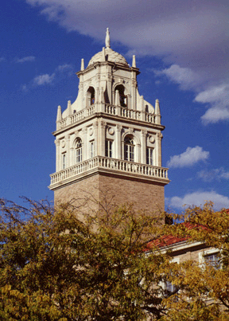
SpacePhaser: Phase Space Embedding Visual Analytics
Presenter
Dr. Tommy Dang
Assistant Professor, Texas Tech University
PhD Students
Ngan V. T. Nguyen

Slide 2
Outline
Introduction
Background and related work
User Interface and interaction
Case study
Conclusion and Future work

Slide 3


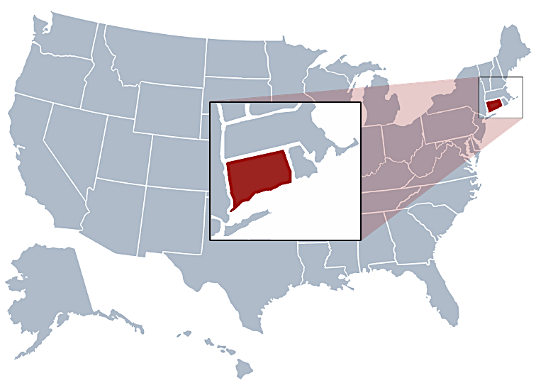

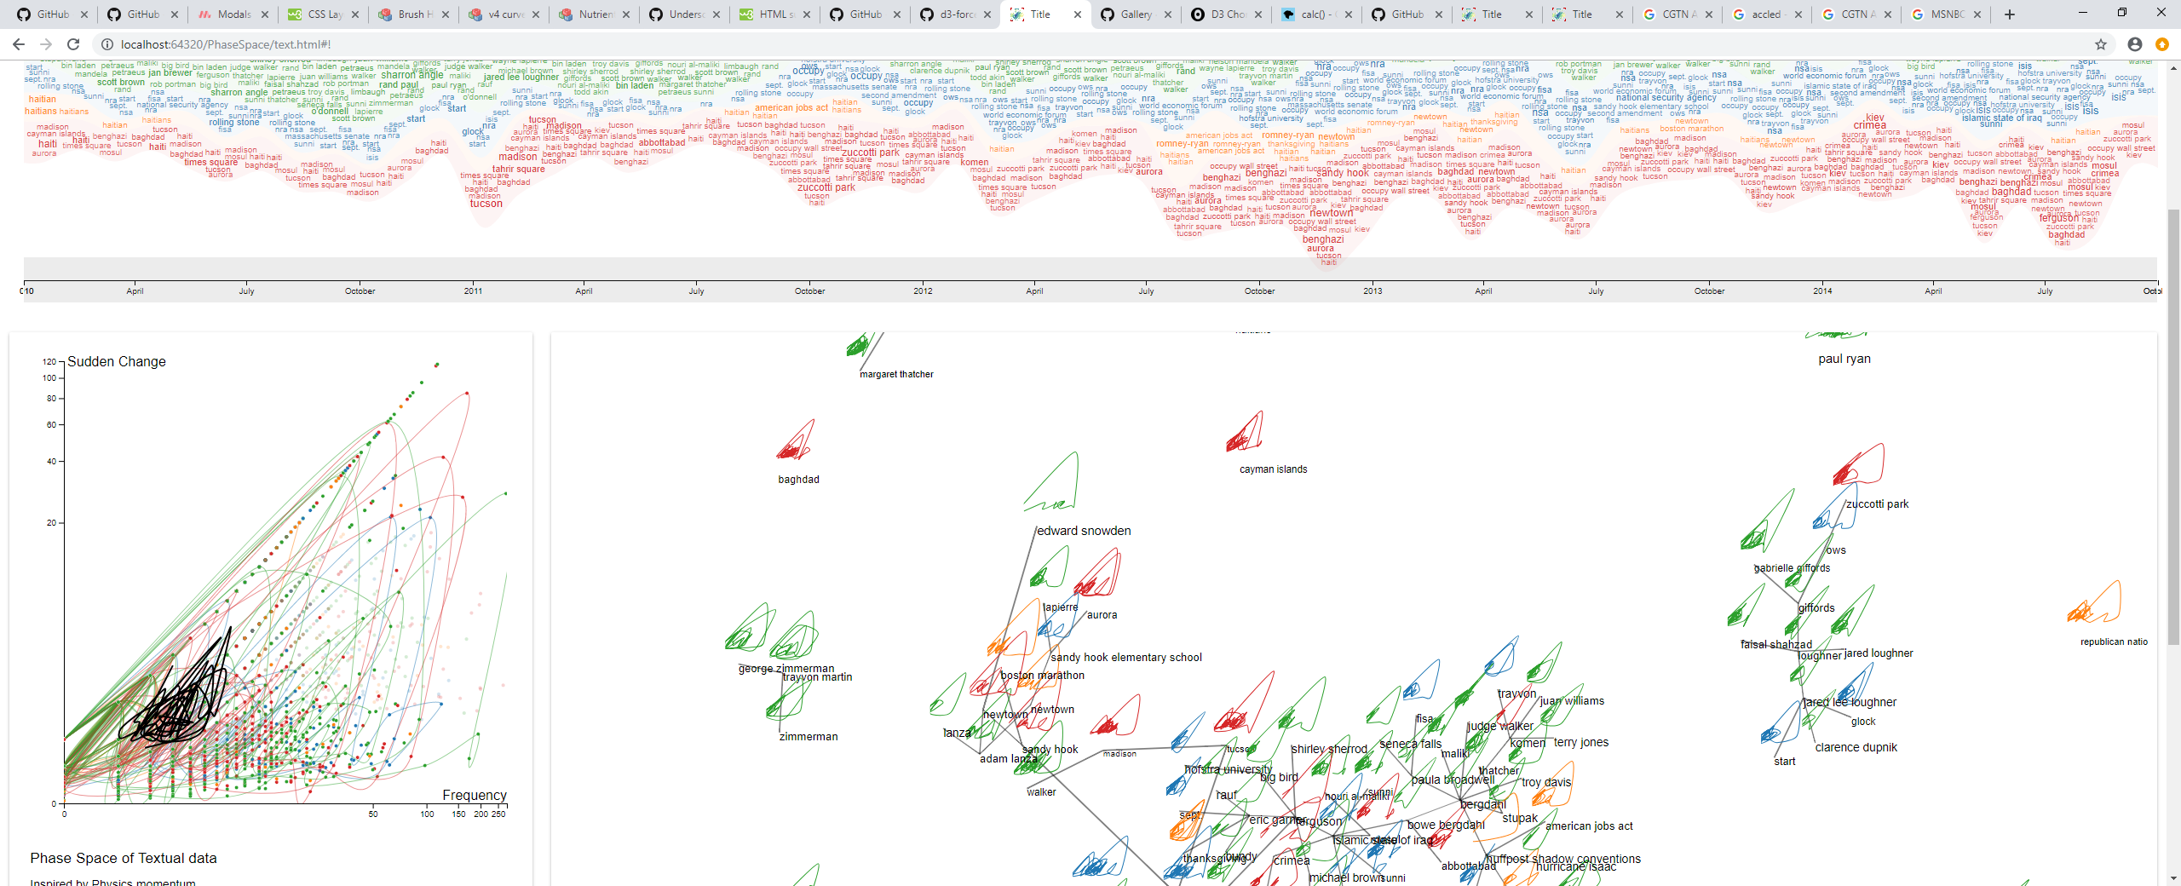
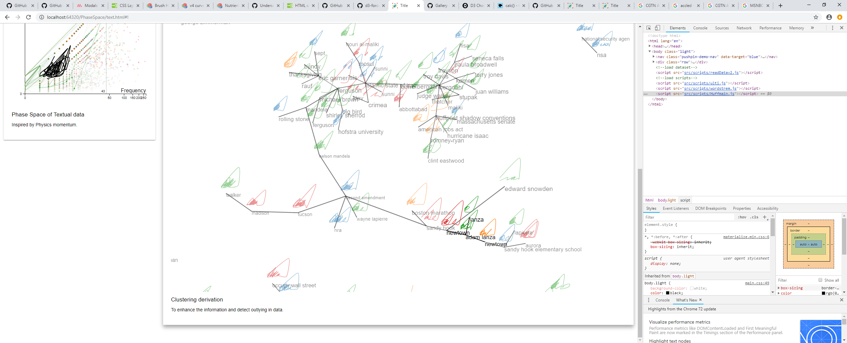





Introduction
(1) Data collecting and cleaning
(2) Data processing and mining
(3) Data visualization
Text entity recognition
Dynamic word cloud
Hate map
adam lanza
Phase space
new town
sandy hook
…
…
Term frequency space
Phase space network
Clustering
Phase space
network
sandy hook
adam lanza

Slide 4
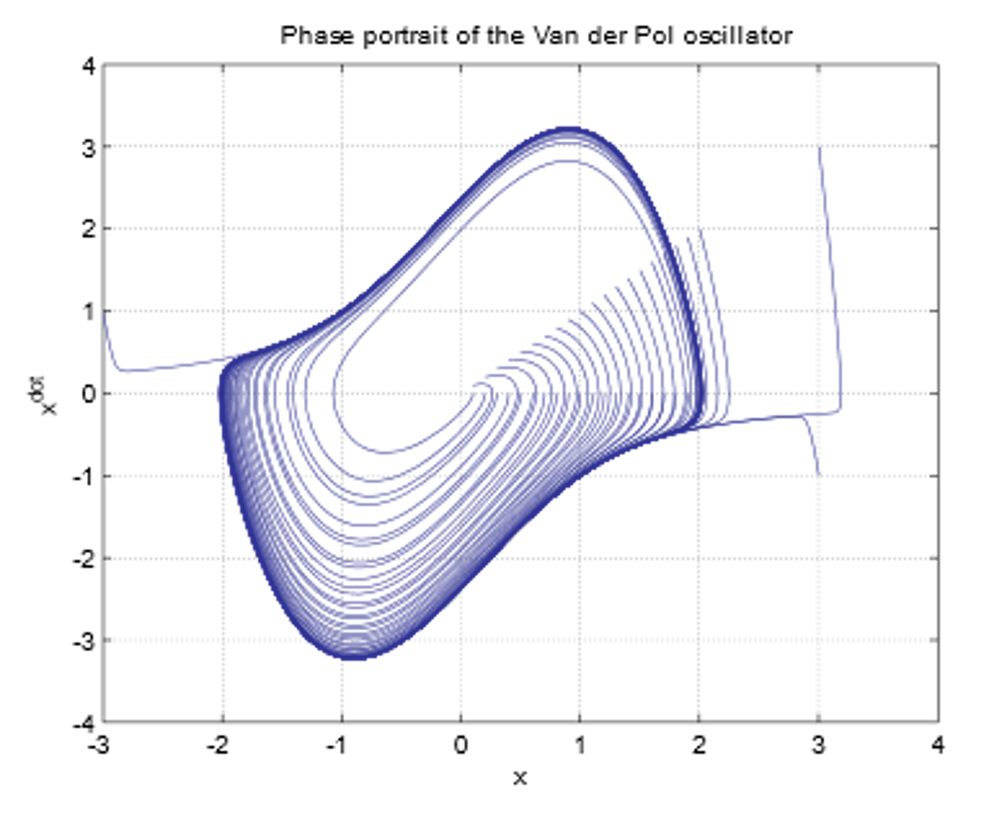
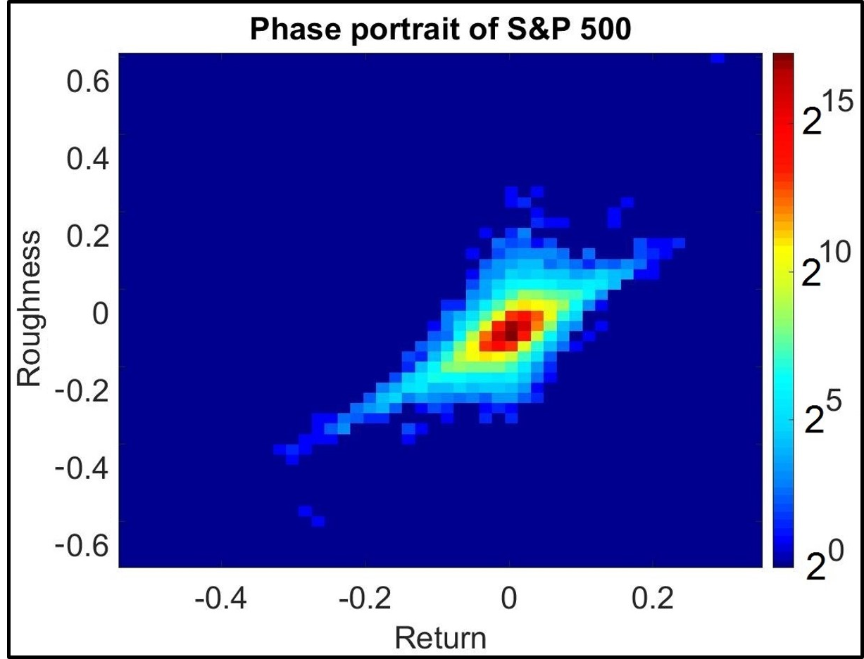
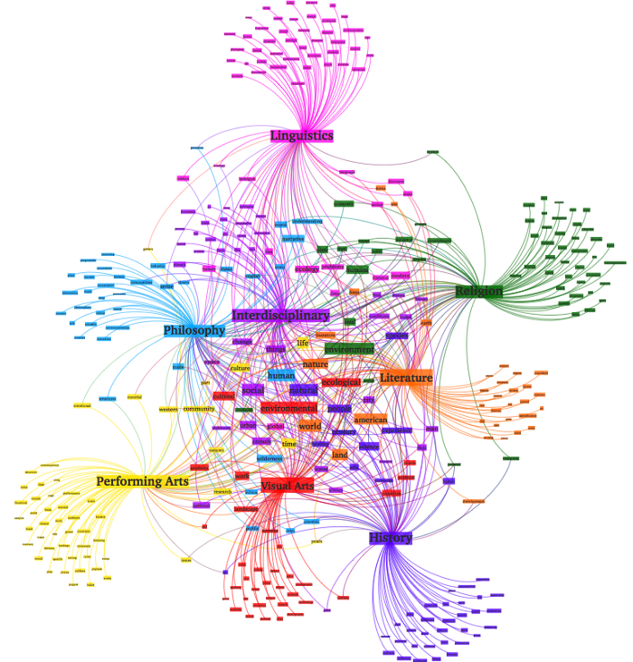
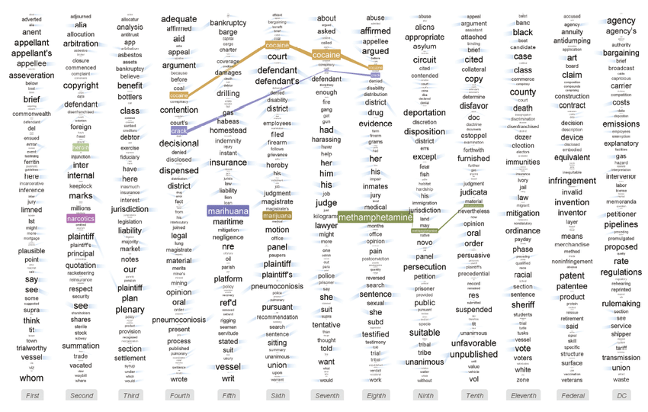
Related work
Phase Space
Text Visualizations
Topic modeling

Slide 5
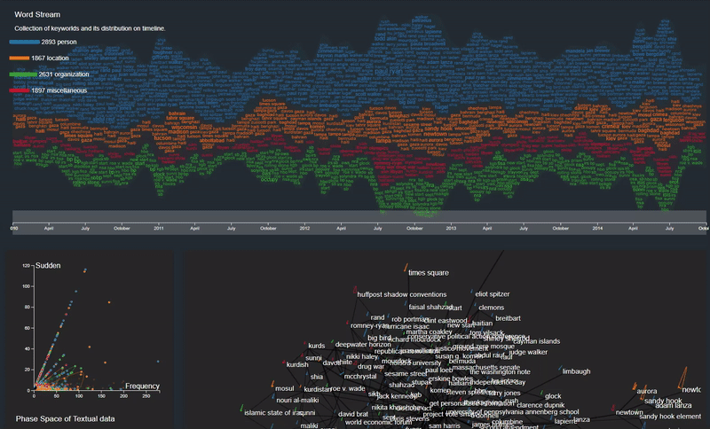
User Interface
Dynamic word cloud
Phase Space graph
Phase space network

Slide 6
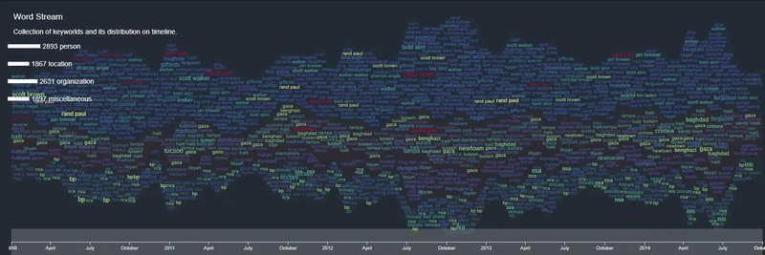
User interactions
Mouse hover: Hight-light term and related terms (similar with phase space network).

Slide 7
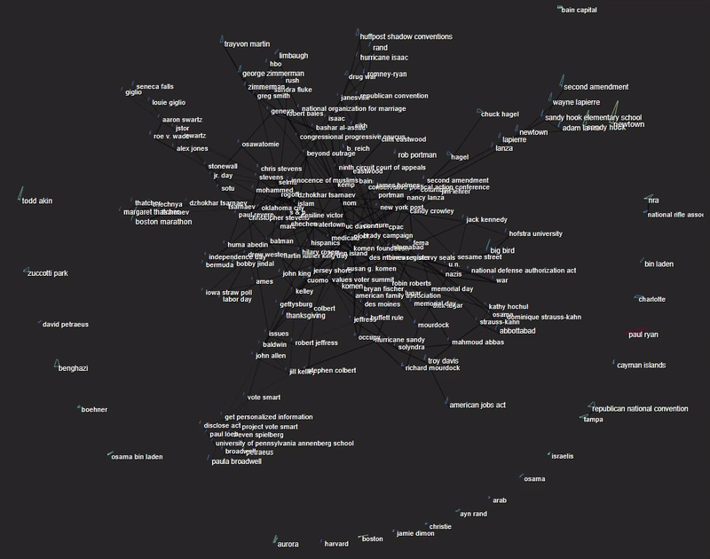
User interactions (cont.)
Mouse event:
Drag and drop
Zoom

Slide 8
Case study

Slide 9
Case study

Slide 10
Conclusion and Future work
We:
Introduced SpacePhaser - an interactive visual prototype for textual pattern analysis based on the dynamical system theory, not only for text analysis but also for other domain such as monitoring the CPU temperature in a high-performance computing center.
Future work:
formal study to validate our approach on different populations of users from various application domains
predictive analysis: building a multiscale hierarchical physical model based on scale dependent anisotropic random walks to incorporated into generative codes

Slide 11


Questions?
Email: Tommy.Dang@ttu.edu
interactive Data Visualization Lab

